Slide 1


GROUP 3: DOWNTOWN DINING
AMY HONG (20219853), ERIC LAM (20229013), LUCY WOLOSZCZUK (20199319), WESLEY LAM (20227388)

Slide 2
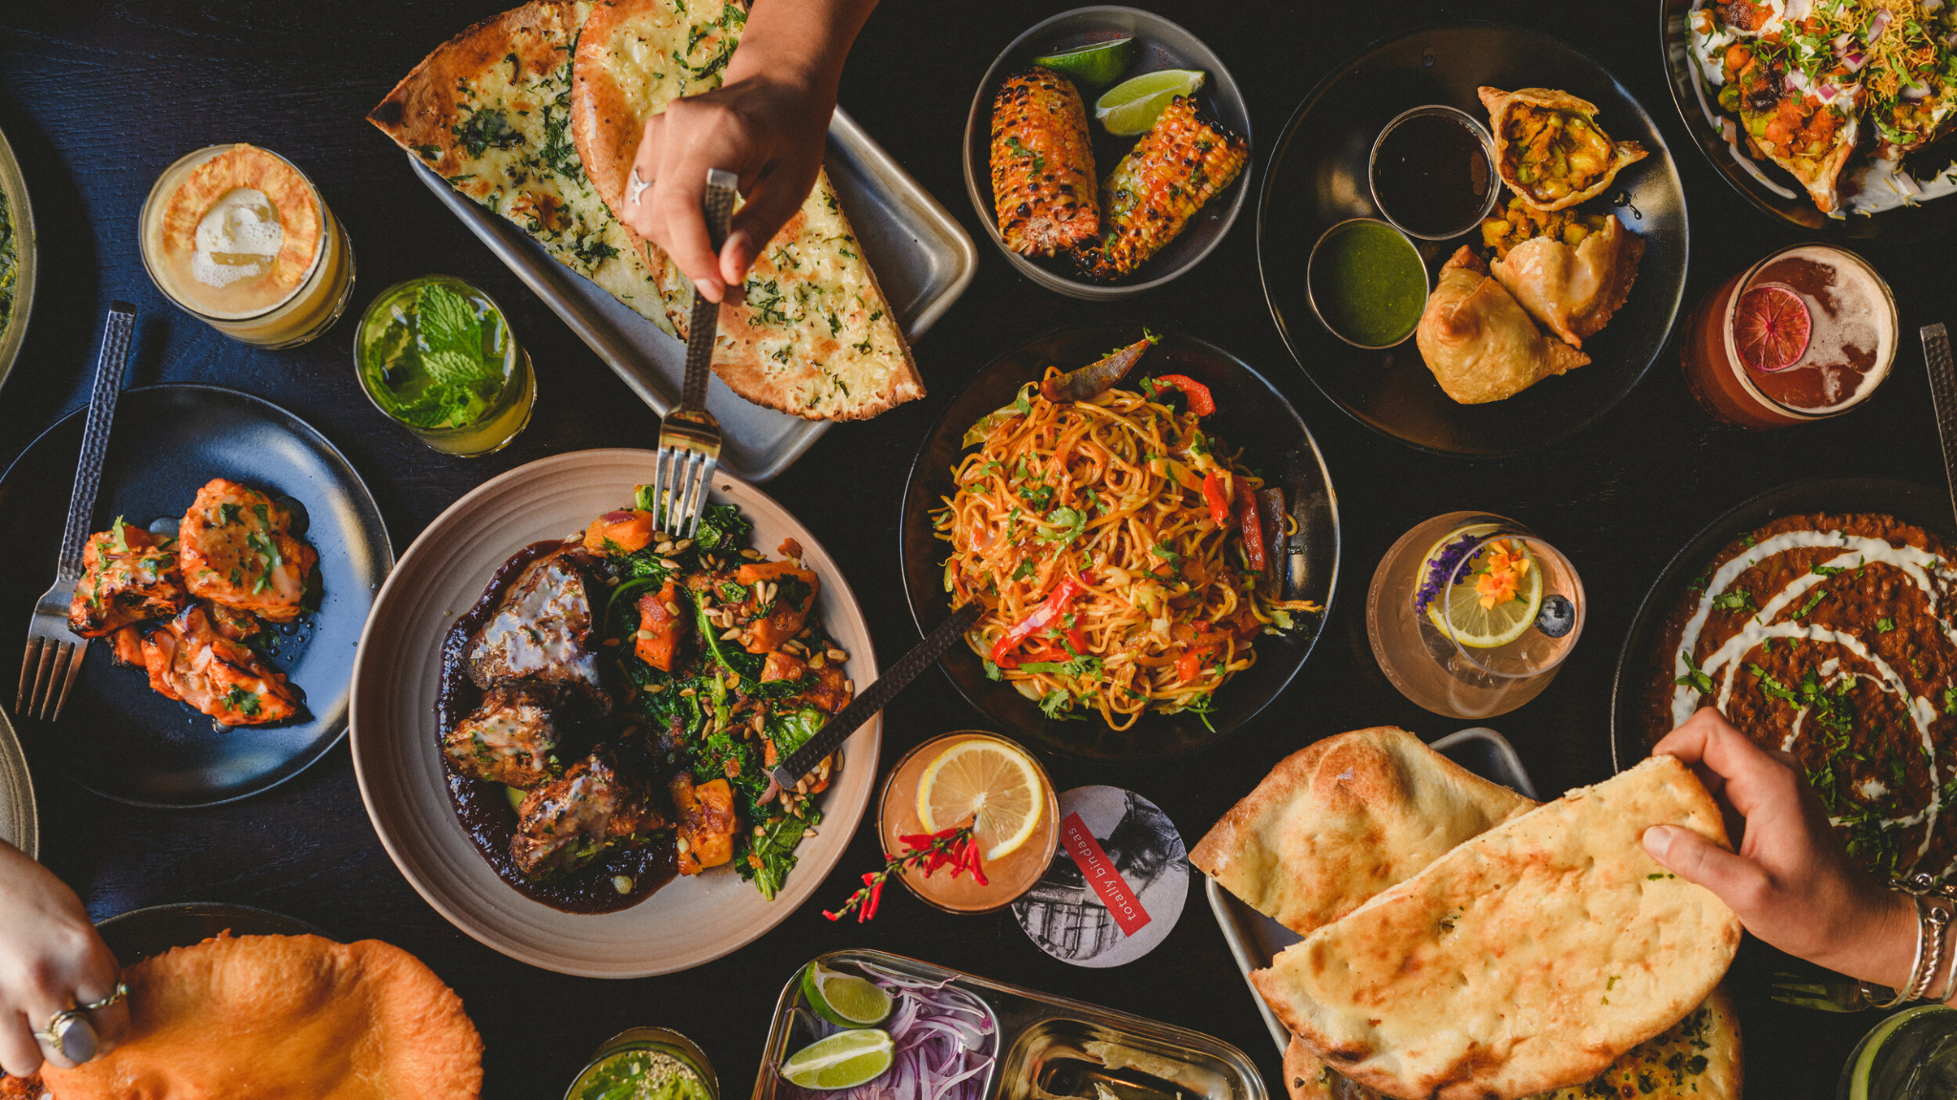
SUMMARY
Choosing a place to eat at isn’t fun at all. In fact, it’s downright distressing! It’s like a visual novel, except that you need to juggle every single one of your friends at once.
So, we’re making dining out easy, by pretending everyone you know has only a handful of defining traits, and forcing a computer to make them choose from a list of your favourite restaurants!
Picture a typical trip with your friends to lovely downtown Kingston - Princess St. in particular! Bellies start rumbling, and you need to decide on a place to eat, quick! Usually, this decision can take a long time, especially when you need to consider the needs and requests of everyone in your party.
Our model will take a list of individuals with a wide variety of needs and preferences, finding all of the options (the best options!) that are palatable for everyone. For the sake of our model, we will consider only restaurants on (the lower part of) Princess St.

Slide 3
PROPOSITIONS
Person (restrictions, preferences): Represents each person in the group students
restrictions (dietary, price): The list of conditions that a restaurant must satisfy
dietary: all restrictions related to food - can be vegetarian, dairy-free, halal
V_{p}: is true if a person is vegetarian, p represents the person
D_{p}: is true if a person is lactose intolerant
H_{p}: is true if a person requires halal food
price: Amount of money spent per person rounded up to the nearest ten (<$10, <$20, <$30)
P_{rj} : is true if the restaurant bill per person is lower than j, where j is the bill price per person
preferences are a list of factors that cause a person to favour a certain restaurant
rating: How many stars does the person require the restaurant to have on Google - can be 1, 2, 3, 4, 5
R_{pk}: is true if the number of stars is greater than or equal to k, where k is the number of stars
seating: Does the person enjoy patio seating?
S_{p}: is true if patio seating is preferred, false if not
Restaurant (attributes): Represents each restaurant on Princess
Attributes: The qualities of a restaurant
dietary: all offerings related to food - can be vegetarian, dairy-free, halal
V_{r}: is true if a restaurant has vegetarian options, r represents the restaurant
D_{r}: is true if a restaurant has dairy-free options
H_{r}: is true if a restaurant has halal options
price: Amount of money and average person spends at the restaurant (<$10, <$20, <$30)
P_{rk}: is true if the restaurant bill per person is lower than j, where j is the bill price per person
rating: How many stars the restaurant has on Google - can be 1, 2, 3, 4, 5
R_{rk}: is true if the number of stars is greater than or equal to k, where k is the number of stars
seating: Is patio seating available?
S_{r}: is true if patio seating is available, false if not
service: is the service “fast”?
T_{r}: is true if the restaurant can be considered to serve “fast food” (e.g. McDonald’s, Tim’s, pizza places…)

Slide 4
CONSTRAINTS
A restaurant must:
be located on Princess St
location(princess) → restaurant
only be associated with one rating:
(rating(a) → ¬rating(a + 1) ⋀ ¬rating(a + 2) ⋀ ¬rating(a - 1)...) for all ratings a
be able to serve a party of size n, assume 4
Restaurant(seating) → (¬restaurant(seating, 0) ⋀ ¬restaurant(seating, 1) ⋀ ¬restaurant(seating, 2) ⋀ ¬restaurant(seating, 3)) ⋀ (restaurant(seating, 4) ⋁ restaurant(seating, 5) ⋁ … ⋁ restaurant(seating, x)) for all available seating x
be open at a given time of day and day of the week
Restaurant(open) → (open_day(day) ⋀ open_time(hour))

Slide 5
END

